Slide 1

Spoiled Beverage Detector
Jahangir Esfandiari (ID:)
Rahmani Rahmani (ID:)
Kymbat Talant (ID:)
Vanessa Mathew (ID: 217957)

Slide 2
Outline
Introduction/Objective
Early Findings (fruit juices and milk)
Current Technologies
Type of Drink + Sensor
Possible Solutions : Option 1 (gas sensor)
Possible Solutions : Option 2 (pH meter)
Components makeup
Demonstration

Slide 3
Introduction/Objective
Consuming Expired Drinks
Effect: Stomach cramp, fever, vomiting, nausea, diarrhea, etc
Option to detect early spoilage takes time
Children not aware of the early signs of expired drinks
Objective: smart cup should be developed in order to detect expired drinks and display the results fast.

Slide 4
Early Findings: Fruit Juices Property
Fruit juices have pH in the acidic range (<4.5) serving as important barrier for microbial growth
Freshly expressed juice, is highly susceptible to spoilage more than whole fruit
Juices | pH range | Mean
Orange | 4.19–4.50 | 4.34
Sweet lime | 4.70–5.47 | 5.08
Carrot | 5.76–6.03 | 5.89
Table 1: pH level of different fruit juices [1]
Notes:
Source: Alicyclobacillus spp. Control in the Fruit Juice Industry
Microbiology of soft drinks and fruit juices (P. Wareing and R.R.) Davenport
-Unprotected by skin or cell walls, fluid components are thoroughly mixed with air and microorganisms from the environment.

Slide 5
Early Findings: Critical factors affecting the spoilage of juices
Intrinsic | Extrinsic
Juice pH | storage temperatures and times
Water activity | relative humidity conditions during storage and packaging material characteristics.
Table 2: Intrinsic & Extrinsic Properties for Juice Spoilage [2]
Effects:
Cloud loss
Development of off-flavors
CO2 production
Changes in color, texture, and appearance
Notes:
Source: Microbiology of soft drinks and fruit juices (P. Wareing and R.R.) Davenport

Slide 6
Motivation for detecting spoiled milk
Important nutrients for humans as wells as for animals
Good milk wastage
Health issues in third world countries
Human senses are often inadequate
Solution: Smart sensing ph-system to make on time descisions.

Slide 7
Composition of cow‘s milk
Table 3: Quantitative composition of milk
Main constituent | Limits of variation | Mean value
Water | 85.5 – 89.5 | 87.5
Total solids | 10.5 – 14.5 | 13.0
Fat | 2.5 – 6.0 | 3.9
Proteins | 2.9 – 5.0 | 3.4
Lactose | 3.6 – 5.5 | 4.8
Minerals | 0.6 – 0.9 | 0.8
The pH value of normal milk is in the range between 6.6-6.8 at
25 °C.
Source: Unknown.“the chemistry of milk“.21 June 2018
<http://dairyprocessinghandbook.com/chapter/chemistry-milk>

Slide 8
Different milk properties
Table 4: Milk forms
Raw Milk | A wide variety of germs
Pasteurized Milk | Coxiella burnetti, Poreformers, Listeria Monocytogenes, Coliforms.
Condensed Milk | Glaucus, Aspergillus repens, Torulopsis.
Dried Milk | Bacillus, Micrococcus, Mucor
Source: Shinde Kajal P. et al.

Slide 9
Early Findings: Fruit Juices + Milk Microorganisms
Microorganisms in spoiled fruit juices
Yeasts
Bacteria
Molds
Mycotoxins
Pathogens
Fruit juices contain a microflora which is normally present on the surface of fruits during harvest and postharvest processing which include transport, storage, and processing.
Common pathogens/bacteria seen both in milk and juice: Salmonella, E. coli., Pseudomonas
Notes:
Source: - Emerging Preservation Techniques for Controlling Spoilage and Pathogenic Microorganisms in Fruit Juices
Microbes Associated with Freshly Prepared Juices of Citrus and Carrots
However, food borne pathogens such as E. coli and Salmonella survive in acidic environment of fruit juices due to acid stress response

Slide 10
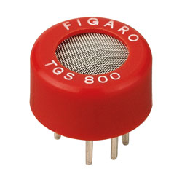
Realization idea number 1 – Gas sensor
Use of a gas sensor TGS 800
Closed measuring chamber
Power Supply
Voltmeter
Figure 1: TGS 800
Source: Unknown.“TGS 800“.22 June 2018
<https://www.google.com/search?q=TGS+800&source=lnms&tbm=isch&sa=X&ved=0ahUKEwititSM7bbAhXMAJoKHeC3DSkQ_AUICygC&biw=1600&bih=763#imgrc=nBKWGIKtMzq6nM:>

Slide 11
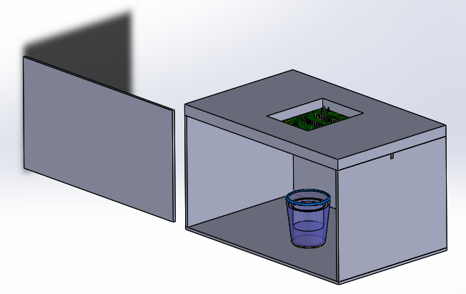
Option 1 (Gas Sensor)
Figure ??: Enclosed Vacuum Glass Box
Drawing: Arduino Part [a] , Cup Part [b]
Drawing assembled by Vanessa.M

Slide 12
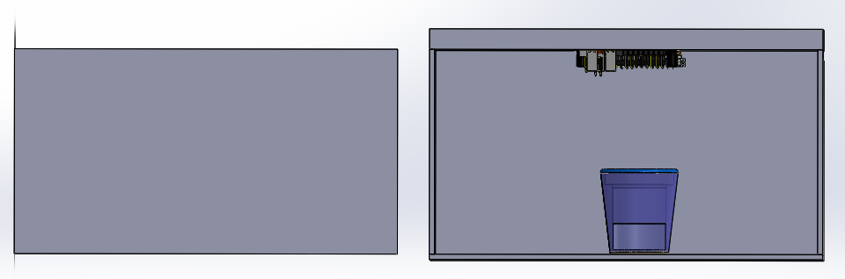
Option 1 (Gas Sensor)
Figure ??: Enclosed Vacuum Glass Box
Drawing: Arduino Part [a] , Cup Part [b]
Drawing assembled by Vanessa.M

Slide 13
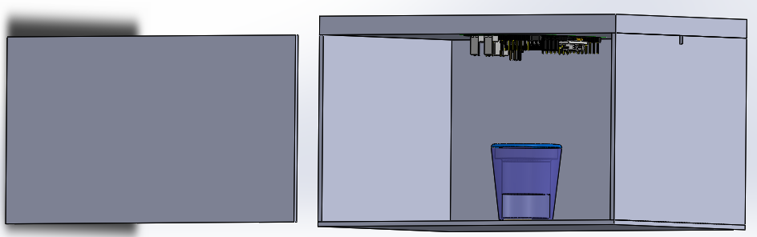
Option 1 (Gas Sensor)
Gas Sensors
Hole for Wiring
Polymer
Glass
Spoiled Milk
Figure ??: Enclosed Vacuum Glass Box
Drawing: Arduino Part [a] , Cup Part [b]
Drawing assembled by Vanessa.M

Slide 14
References
[1] Alicyclobacillus spp. Control in the Fruit Juice Industry
[2] Microbiology of soft drinks and fruit juices (P. Wareing and R.R.) Davenport
[3]
[a] https://grabcad.com/library/circuit-board-pcb-mock-example
[b] https://grabcad.com/library/agian-glass-1

